Slide 1

Department of Computer Engineering
Sequential Logic Design – Synchronous Counter
1

Slide 2
Points covered
Department of Computer Engineering
Introduction
Synchronous UP Counter
Synchronous DOWN Counter
2

Slide 3
Department Vision & Mission
Department of Computer Engineering
Vision
Achieve academic excellence through education in computing, to create intellectual manpower to explore professional, higher educational and social opportunities.
Mission
To impart learning by educating students with conceptual knowledge and hands on practices using modern tools, FOSS technologies and competency skills there by igniting the young minds for innovative thinking, professional expertise and research.

Slide 4
Department of Computer Engineering
J K Flip Flop
JK truth table
JK excitation table
J | K | Qn+1
0 | 0 | Qn
0 | 1 | 0
1 | 0 | 1
1 | 1 | Qn’
Qn | Qn+1 | J | K
0 | 0 | 0 | X
0 | 1 | 1 | X
1 | 0 | X | 1
1 | 1 | X | 0

Slide 5
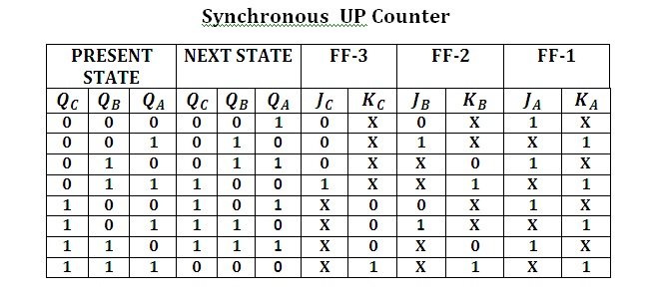
The 3-bit UP-Counter counts the binary number from 0 to 7
Department of Computer Engineering
JK
Excitation
table
Qn | Qn+1 | J | K
0 | 0 | 0 | X
0 | 1 | 1 | X
1 | 0 | X | 1
1 | 1 | X | 0

Slide 6
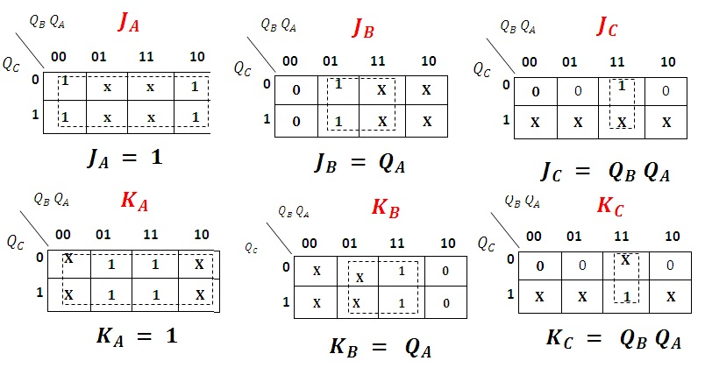
K-Map and Simplification
Department of Computer Engineering

Slide 7
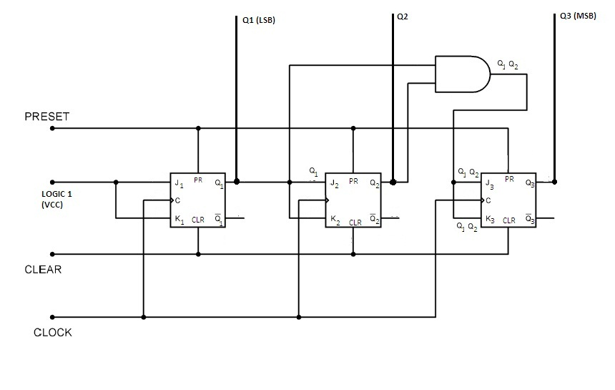
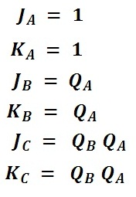
Synchronous UP-Count Circuit Diagram
Department of Computer Engineering

Slide 8
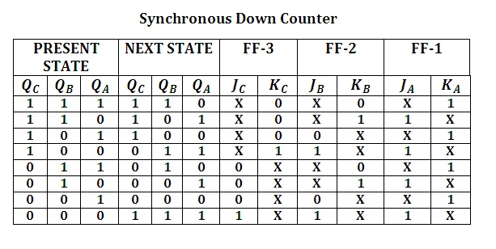
The 3-bit Down-Counter counts the binary number from 7 to 0
Department of Computer Engineering
JK
Excitation
table
Qn | Qn+1 | J | K
0 | 0 | 0 | X
0 | 1 | 1 | X
1 | 0 | X | 1
1 | 1 | X | 0

Slide 9
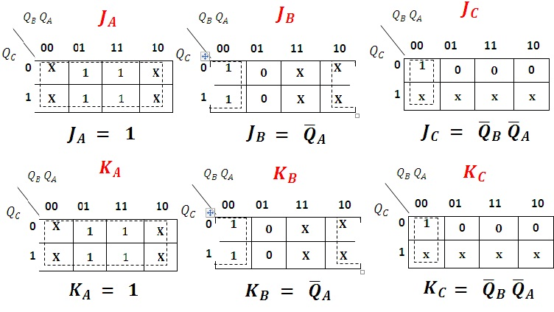
K-Map and Simplification
Department of Computer Engineering

Slide 10
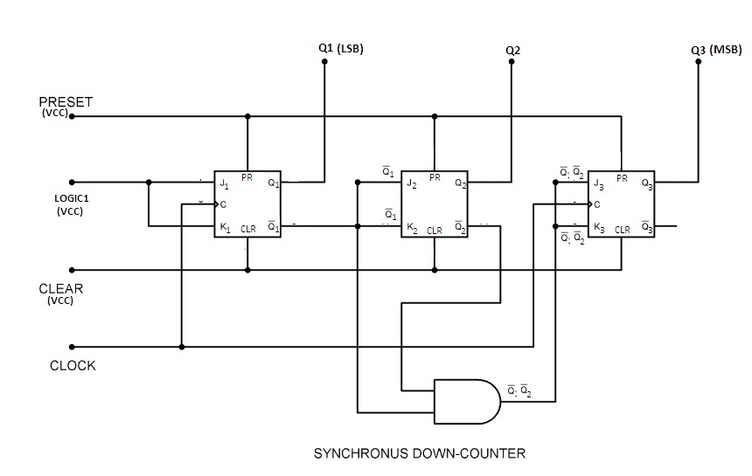
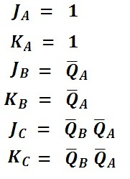
Synchronous DOWN-Count Circuit Diagram:
Department of Computer Engineering

Slide 11
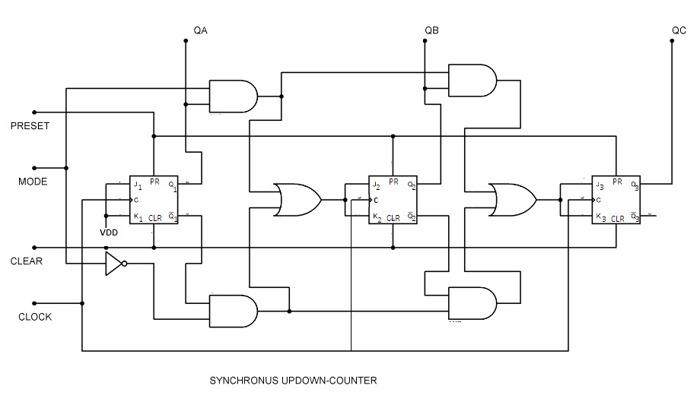
Synchronous UP-DOWN Count Circuit Diagram:

Slide 12
Department of Computer Engineering
Thank you

